Slide 1

S.A.S. Travel
“Welcome to our travel blog. We created this backend application to create a community where multiverse apprentices can share their travel journeys while learning how to “ + ${area of study}`

Slide 2
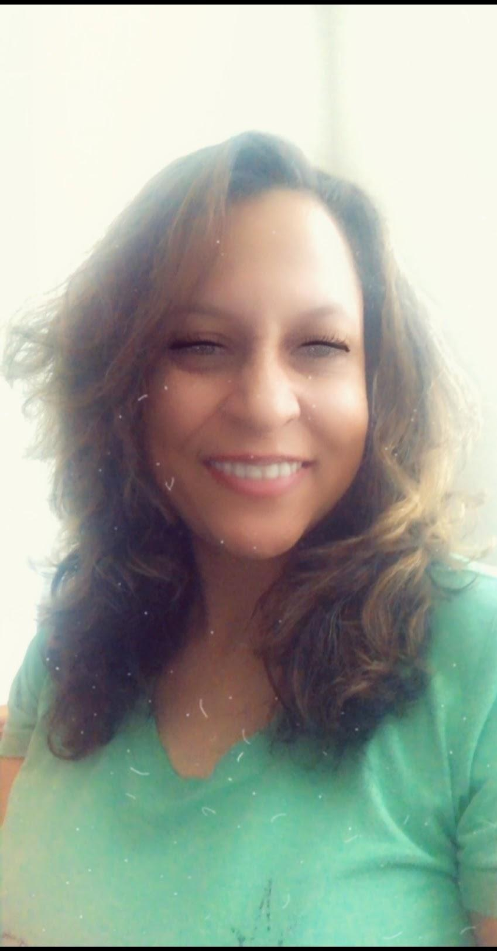
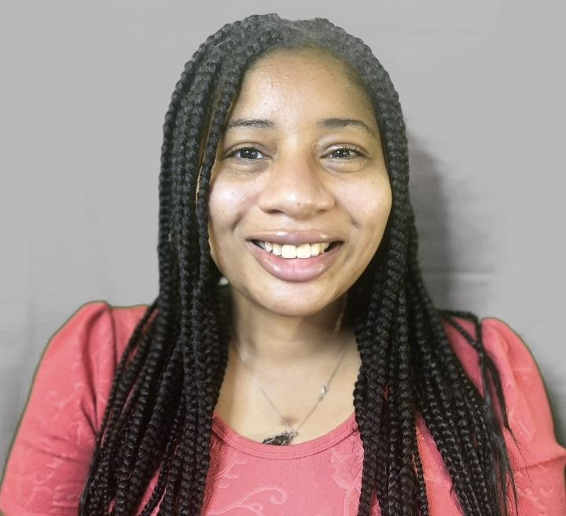
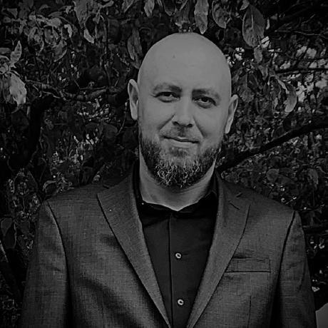
Sheree Adrian Sharee
Introducing S.A.S Travel Thrive Apprenticeship
Junior Web Developer
https://github.com/adrianbaltag
Cyber Security
https://github.com/nukandtudasmom
Fullstack Java Developer
https://github.com/Sheree1986

Slide 3
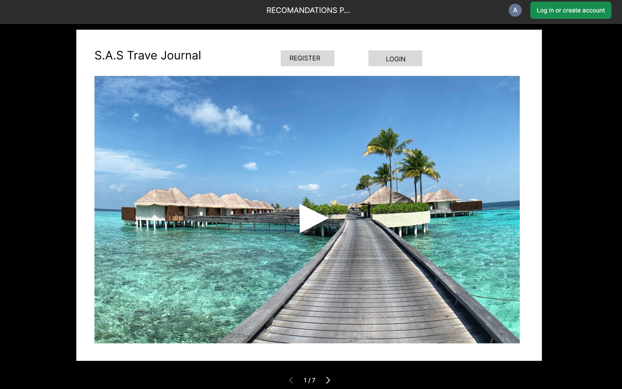
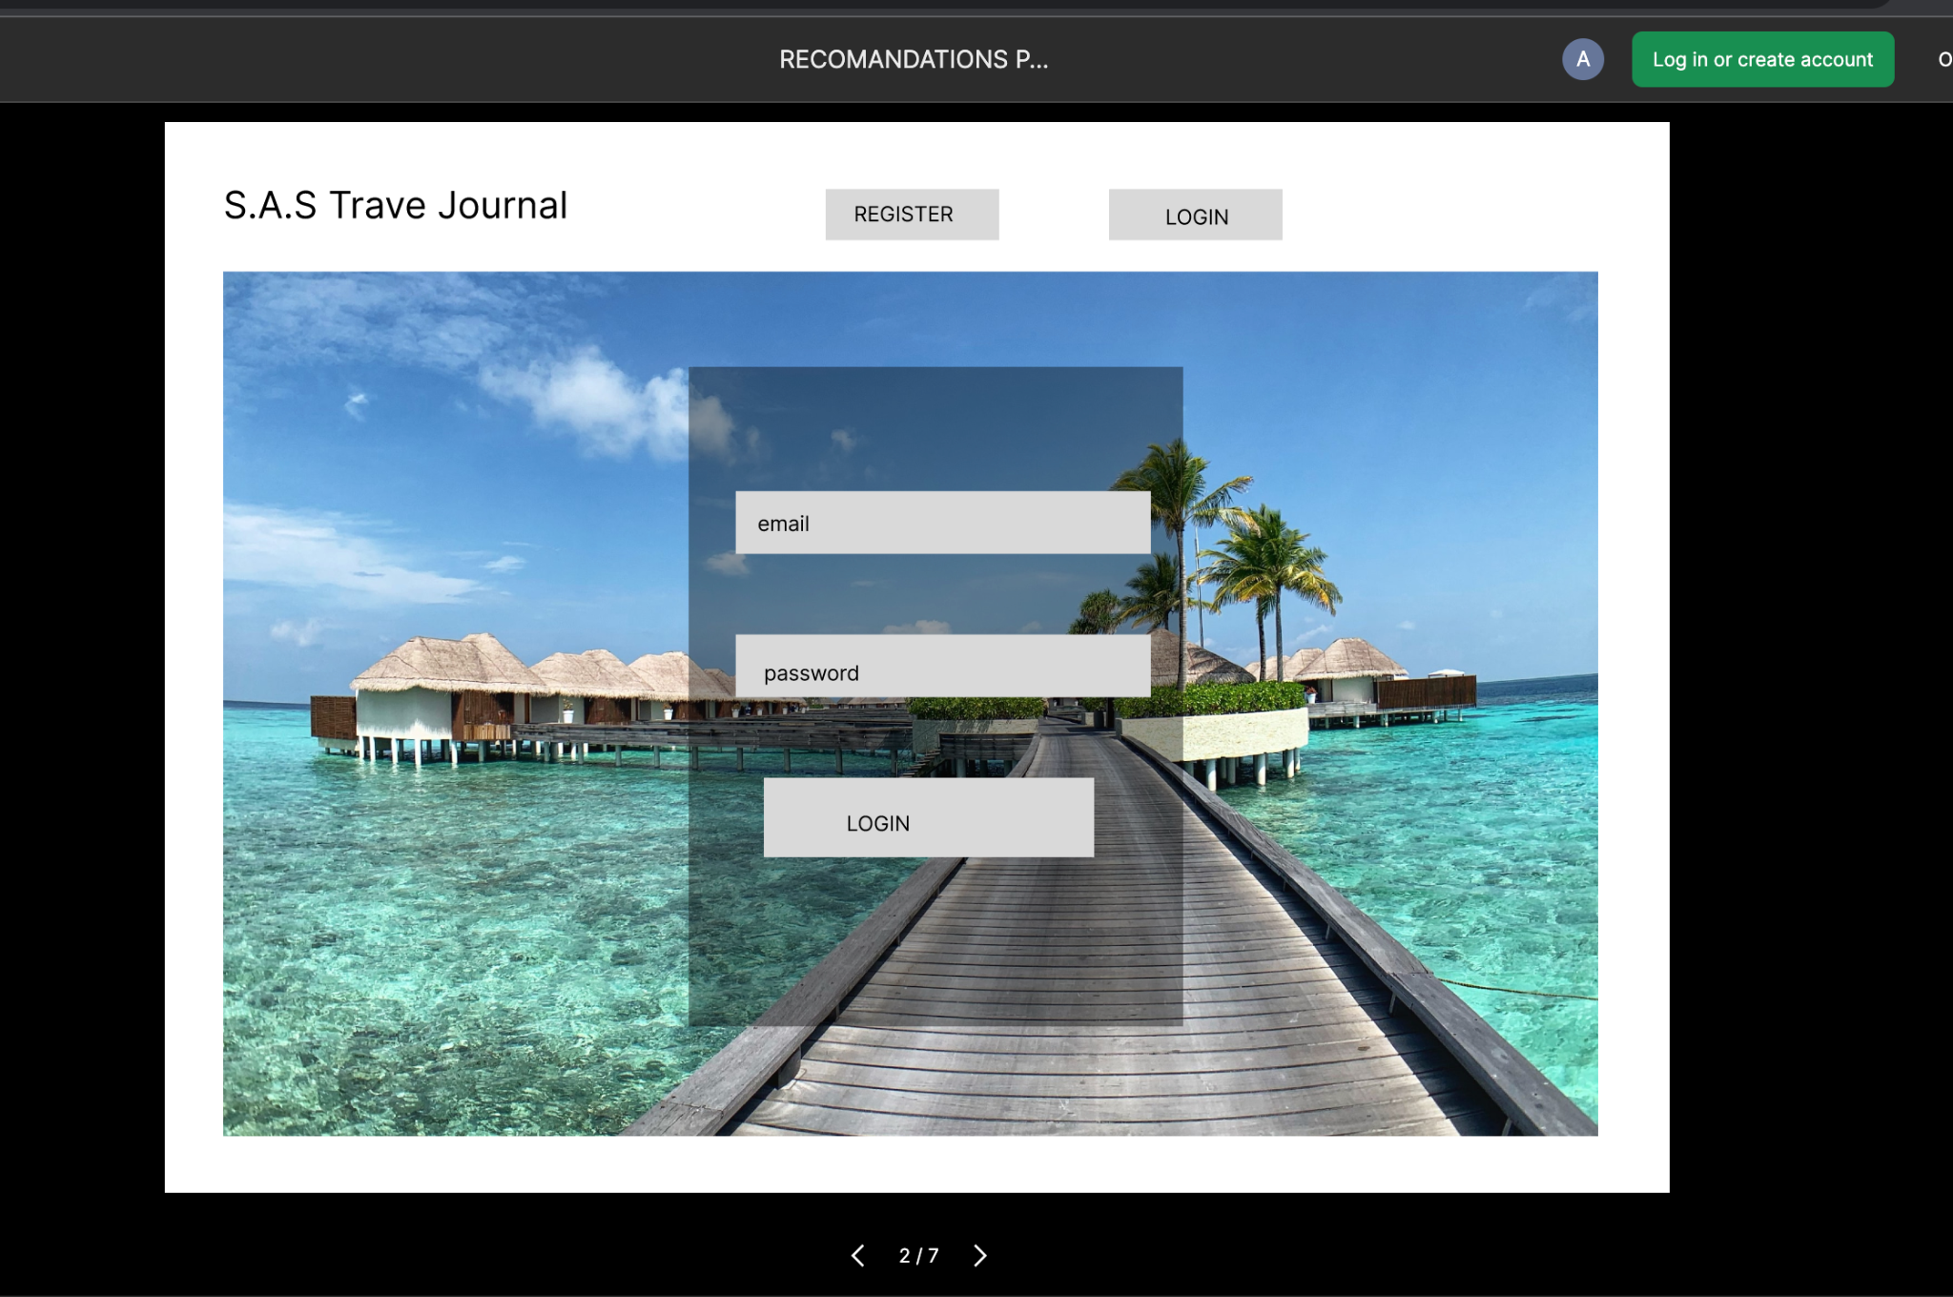
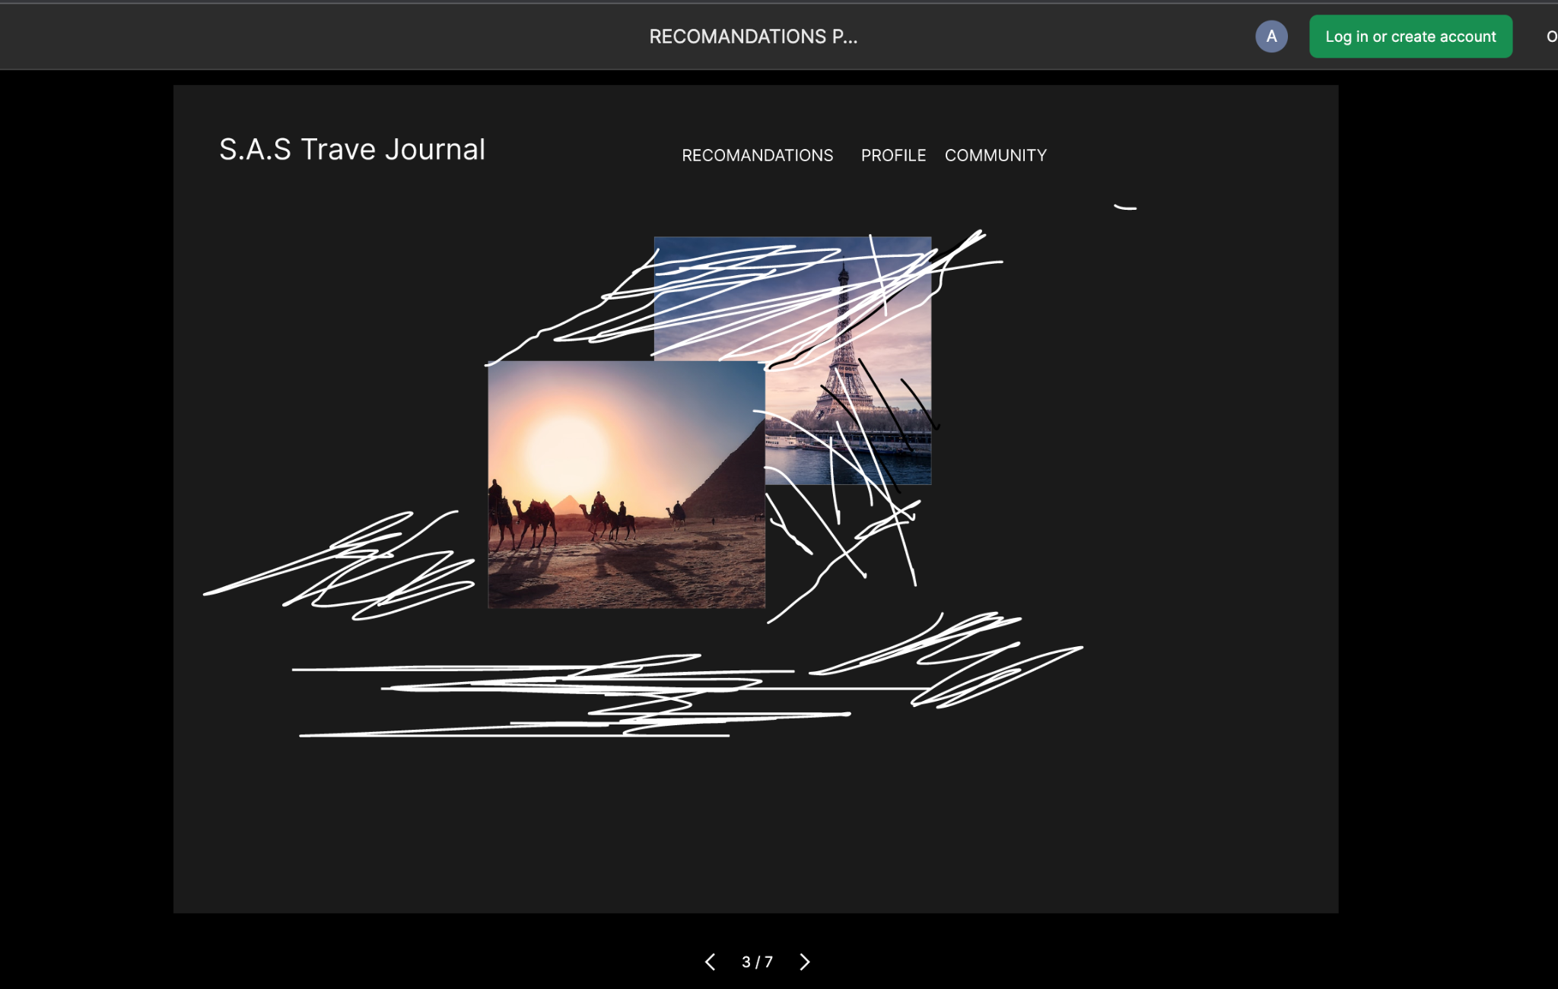
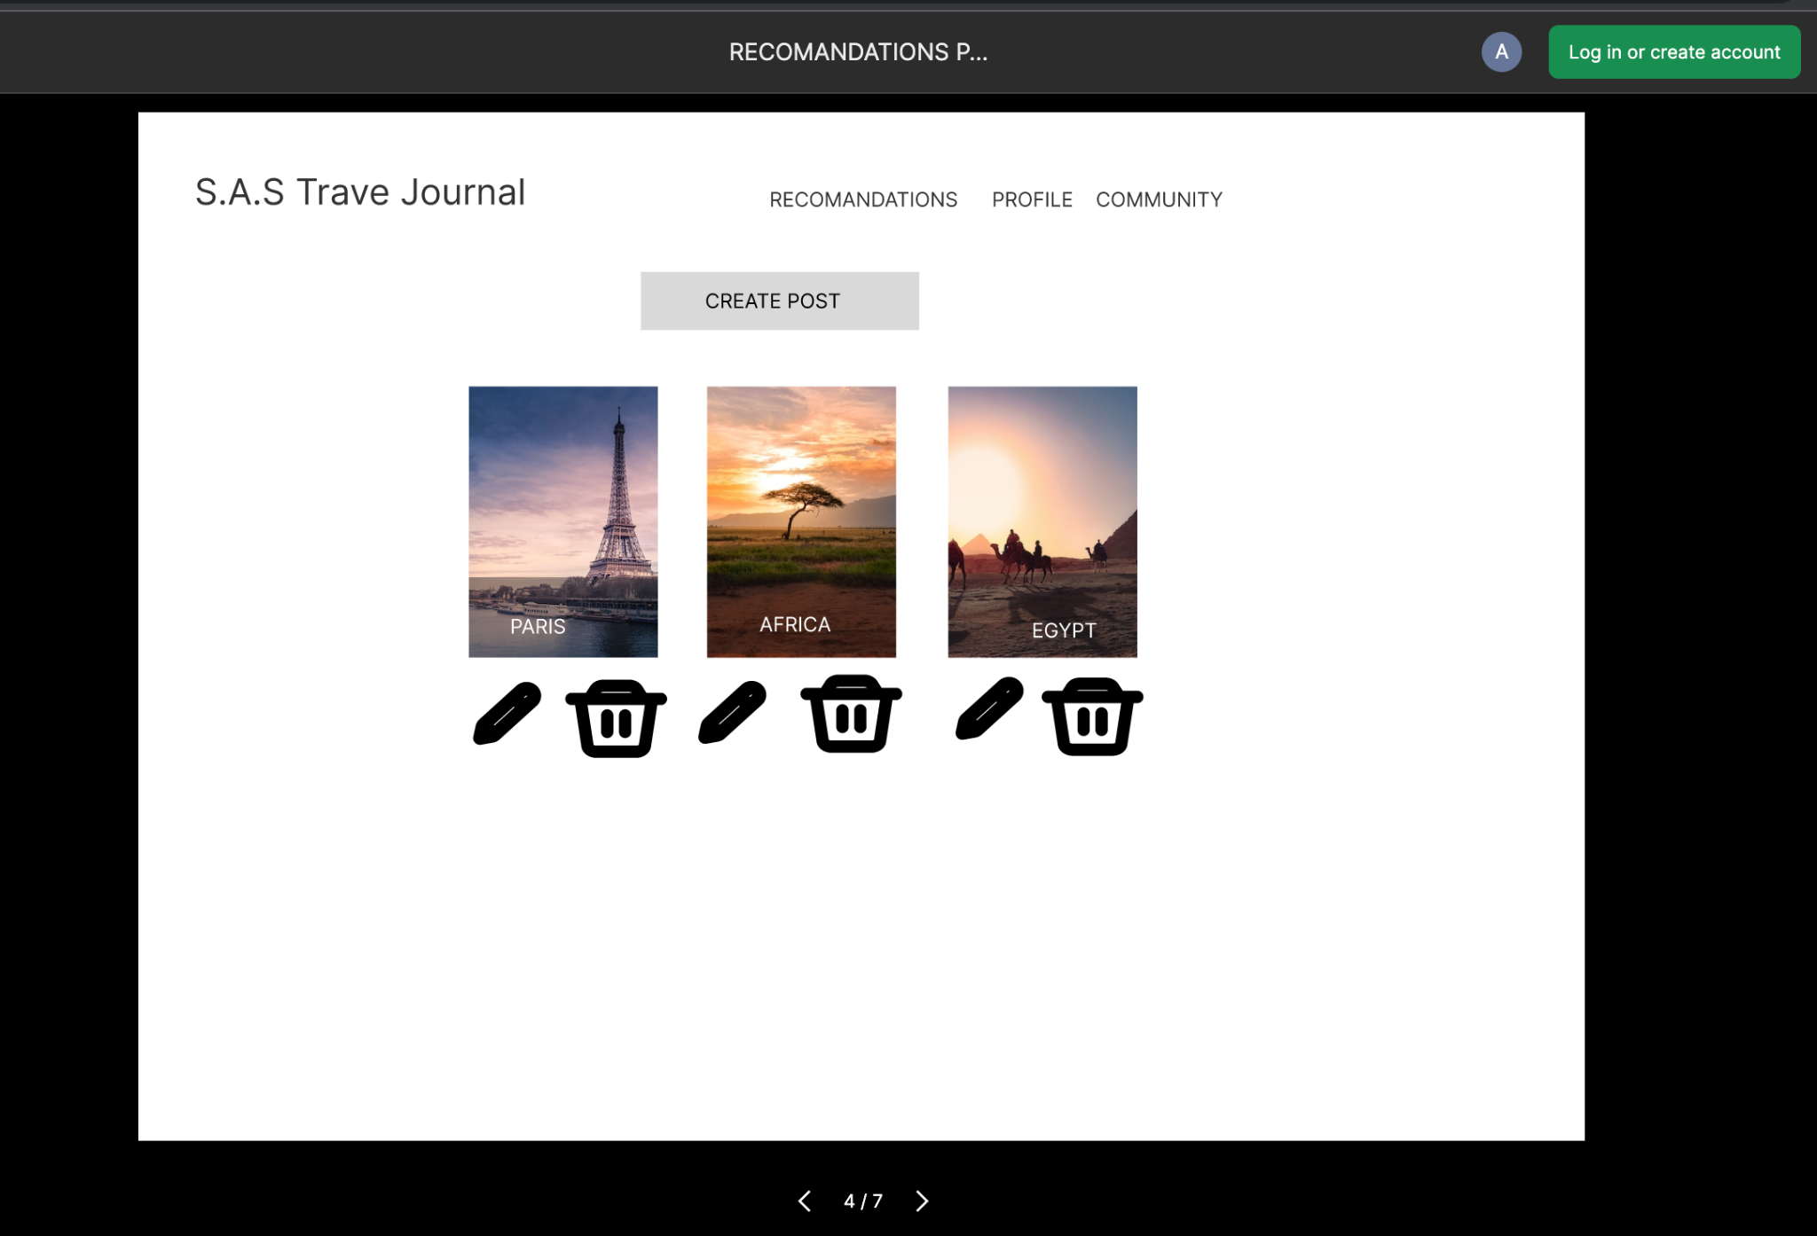
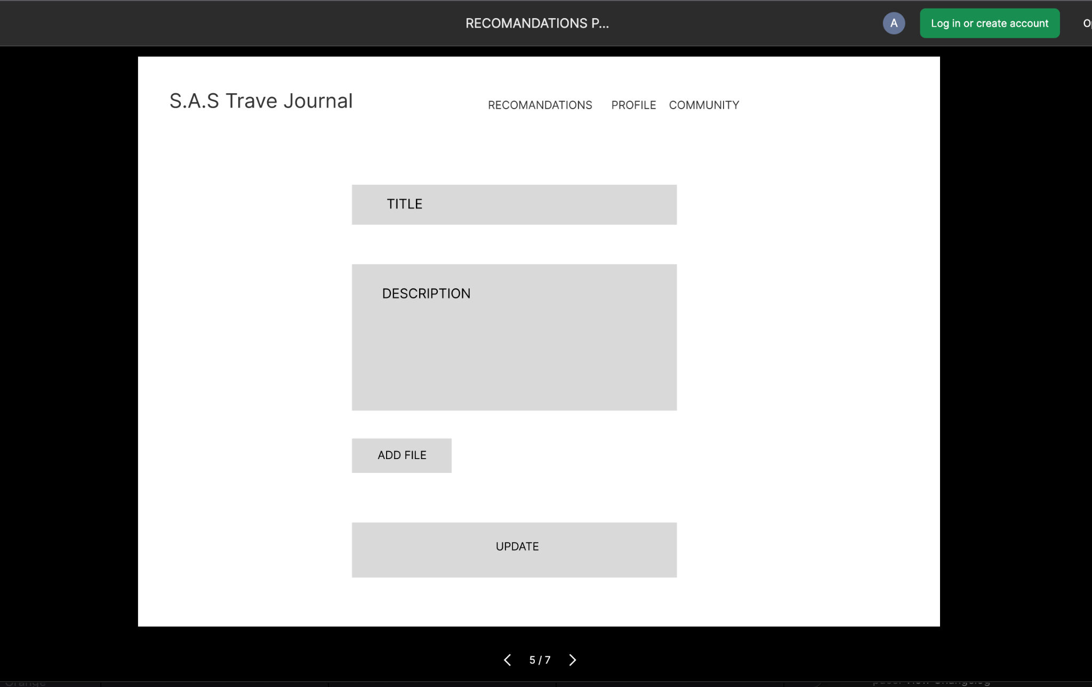
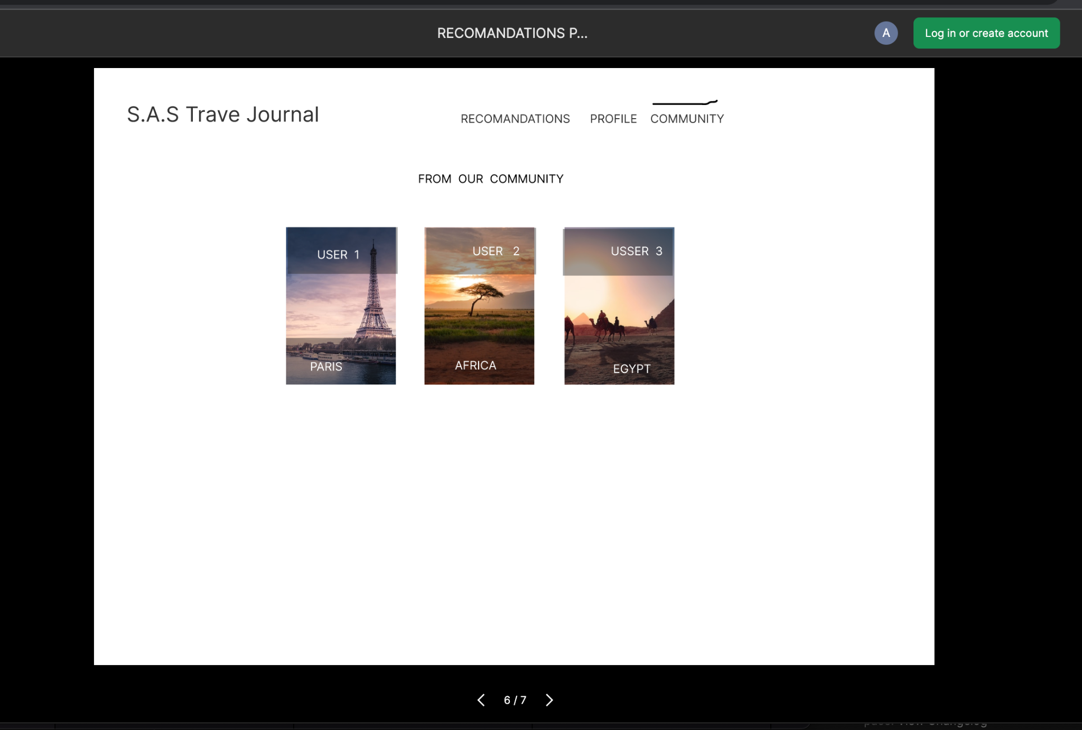
Wireframe

Slide 4
Wireframe cont.
https://www.figma.com/proto/V8sXjQzUDKKHm7ic4ioDKz/RECOMANDATIONS-PAGE?node-id=1%3A2&scaling=contain

Slide 5
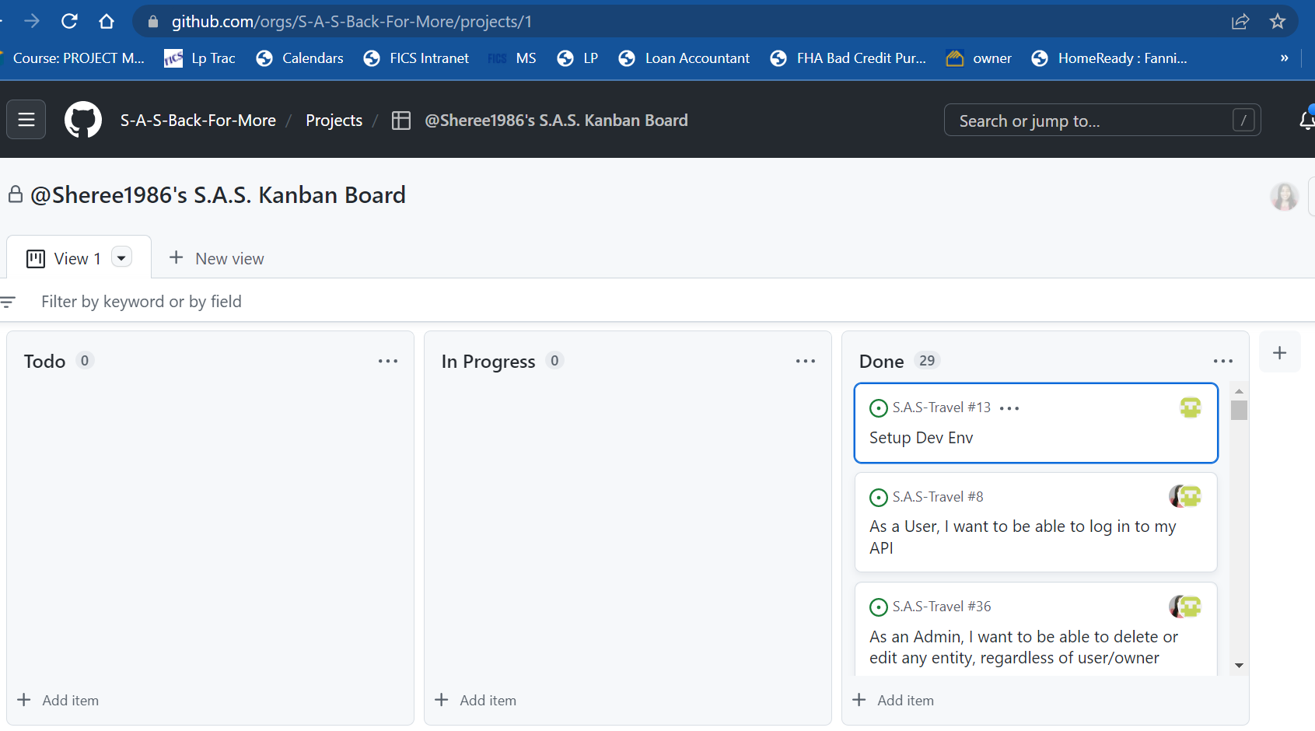
Kanban Board - PM Planning
Notes:
Project Management /GIT

Slide 6

Documentation - Readme File

Slide 7
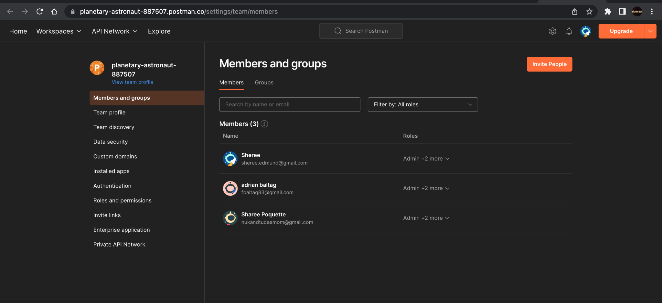
API - Postman Collaboration
Notes:
API services utilized in Postman - this service allows for a collaborative environment when setting up the API

Slide 8
Database - MongoDB Atlas

Slide 9
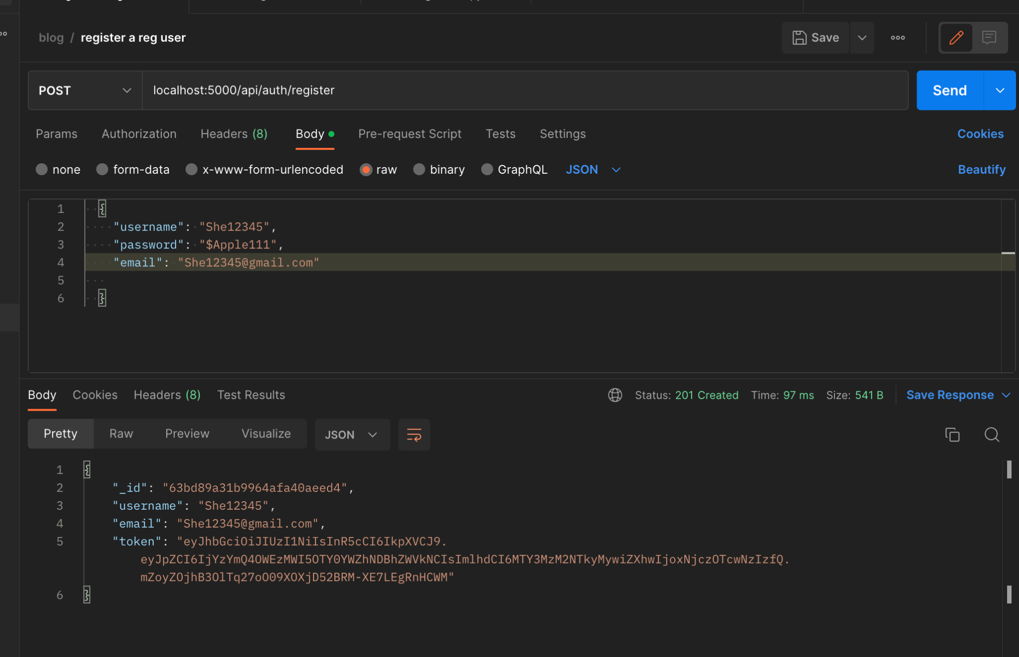
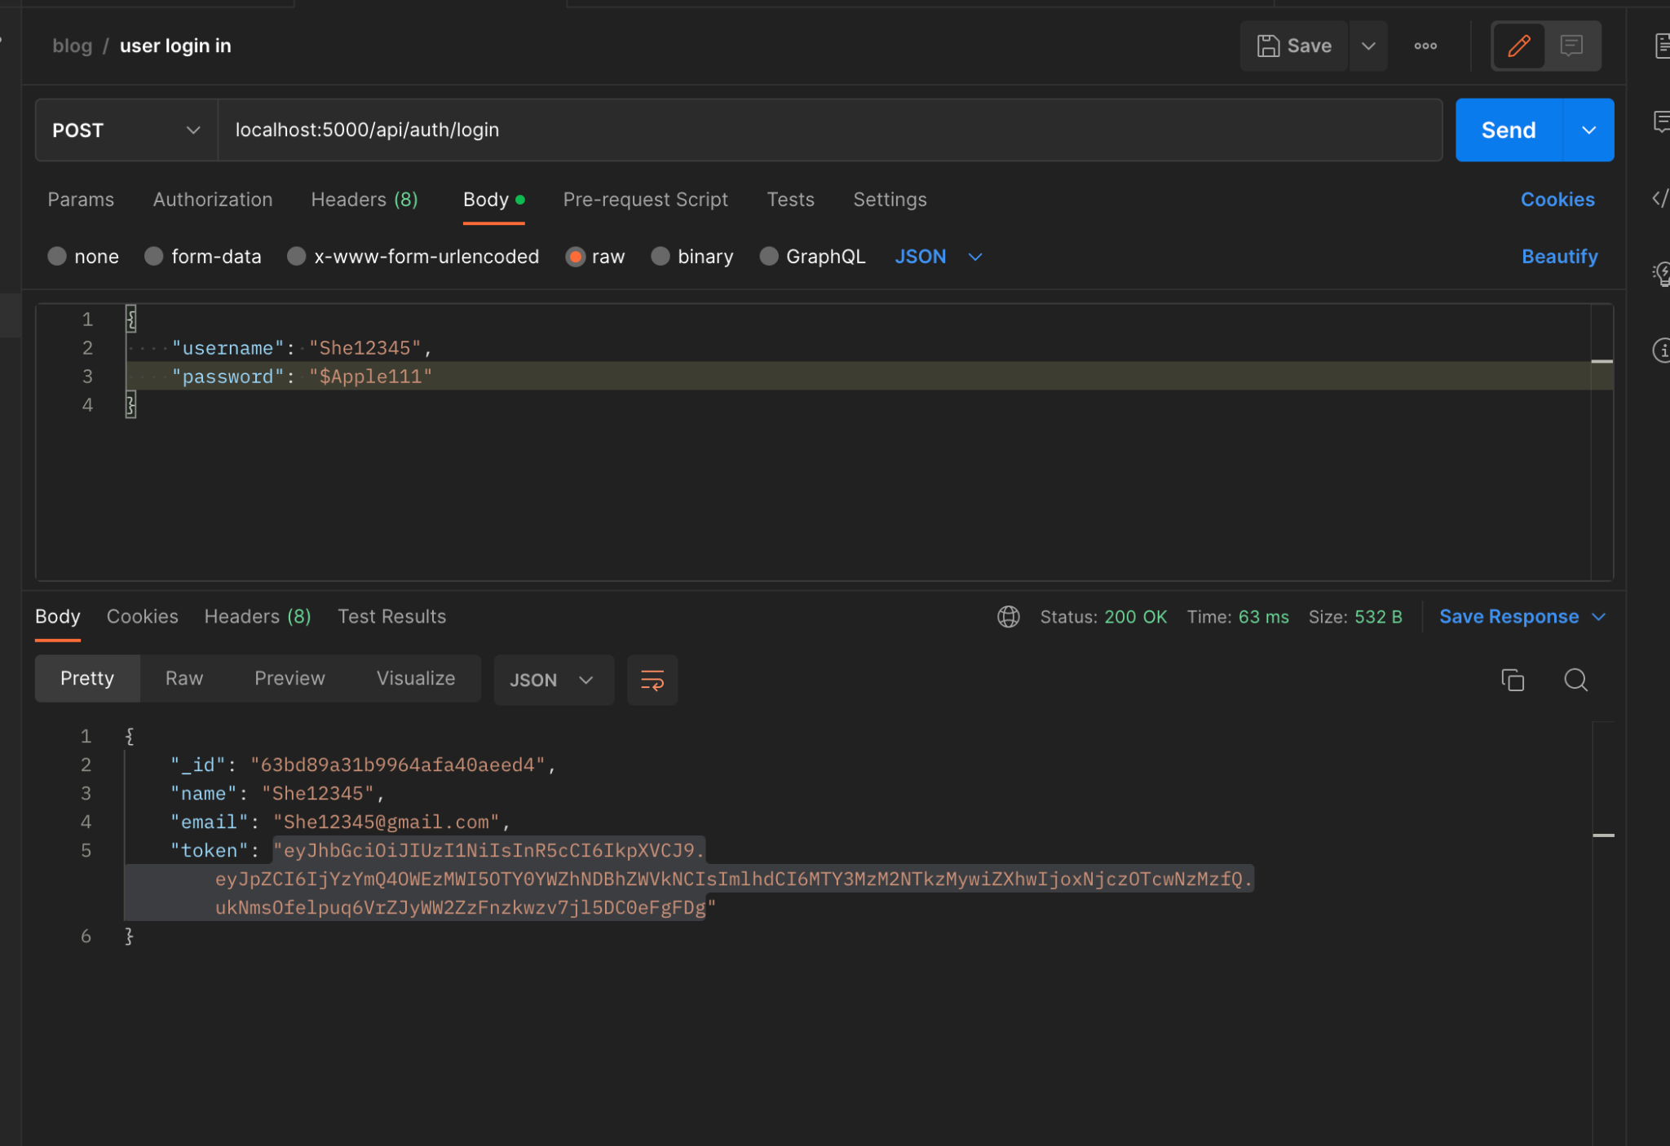
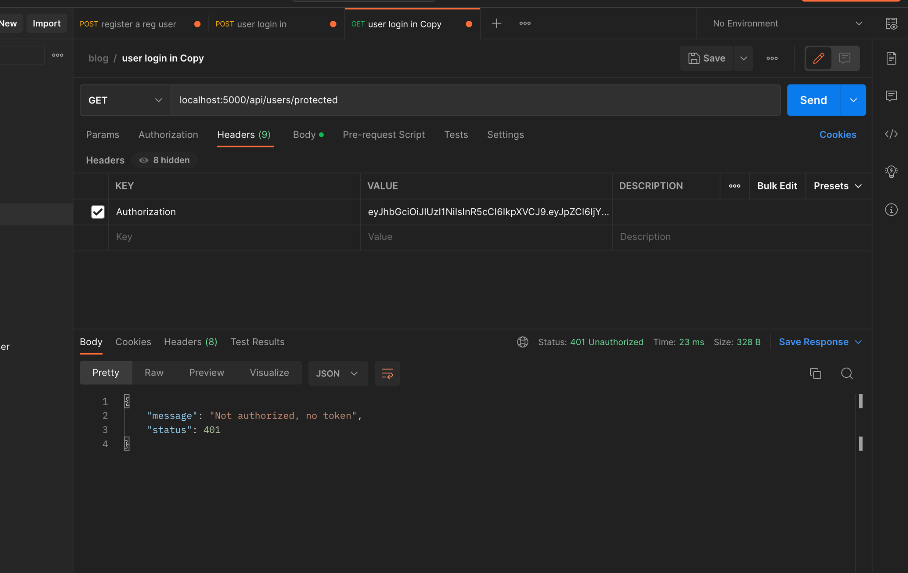
Peaks and Pits
Pit Deployment
Authorization failed, although jwt token was generated.
Peak Deployment Backend & switching to Mongoose:
Repo prior to switching to mongoose - (https://github.com/Sheree1986/testing)
Link to deployment - https://s-a-s-travel.onrender.com/

Slide 10
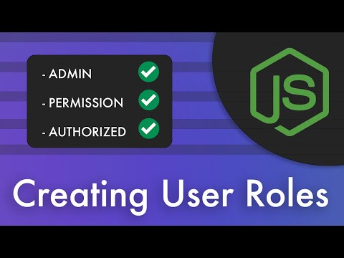
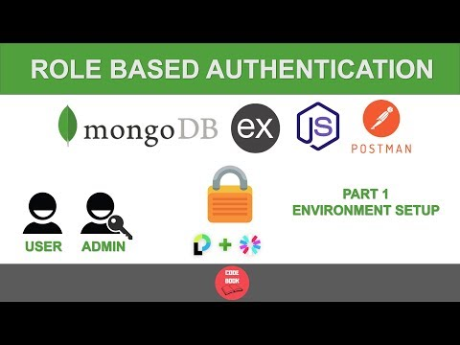
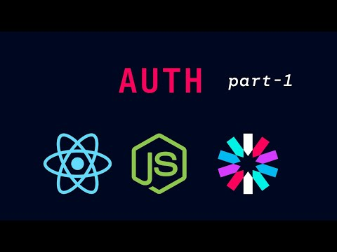
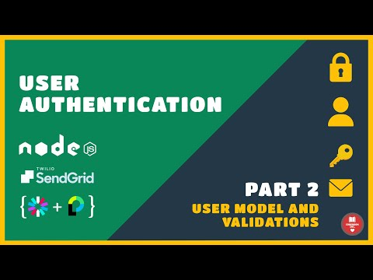
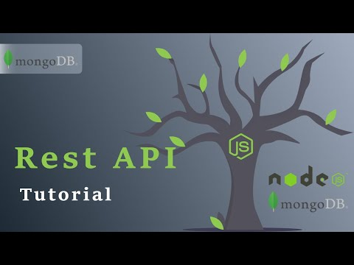
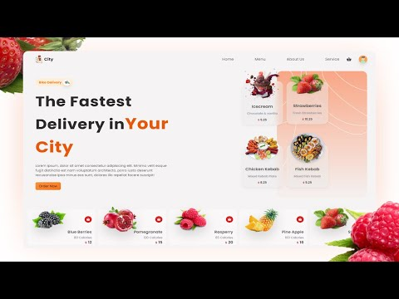
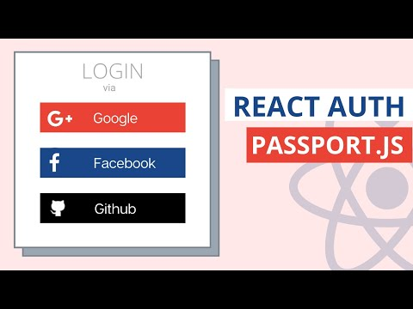
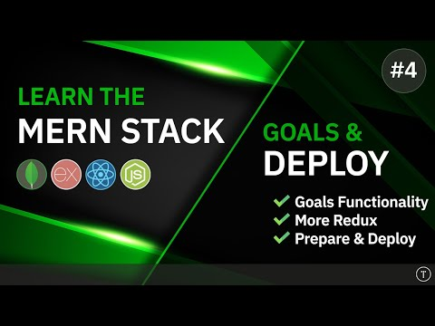
References - few helpful video tutorials
Notes:
https://www.youtube.com/watch?v=C8OO7Fk7RnA&list=WL&index=11
https://www.youtube.com/watch?v=99EZ3798V9w&list=WL&index=9&t=305s
https://www.youtube.com/watch?v=l2MiGPlfrUs&list=WL&index=6&t=3064s
https://www.youtube.com/watch?v=kmU7uX3ZHJc&list=WL&index=4
https://www.youtube.com/watch?v=7K9kDrtc4S8&list=WL&index=3&t=3106s
https://www.youtube.com/watch?v=UXjMo25Nnvc&t=112s

Slide 12

Learning Moments a.k.a Hair pulling moments
Adrian pulled the most
AWS Lambda
Azure Active Directory Services
Notes:
Learning moments
Trying to user microservices for a small scale project

Slide 13
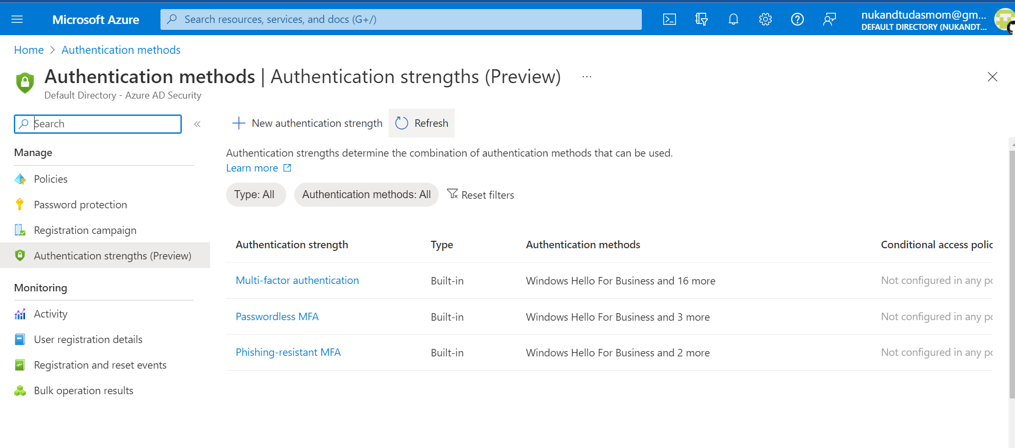
Azure Multifactor Authentication

Slide 14
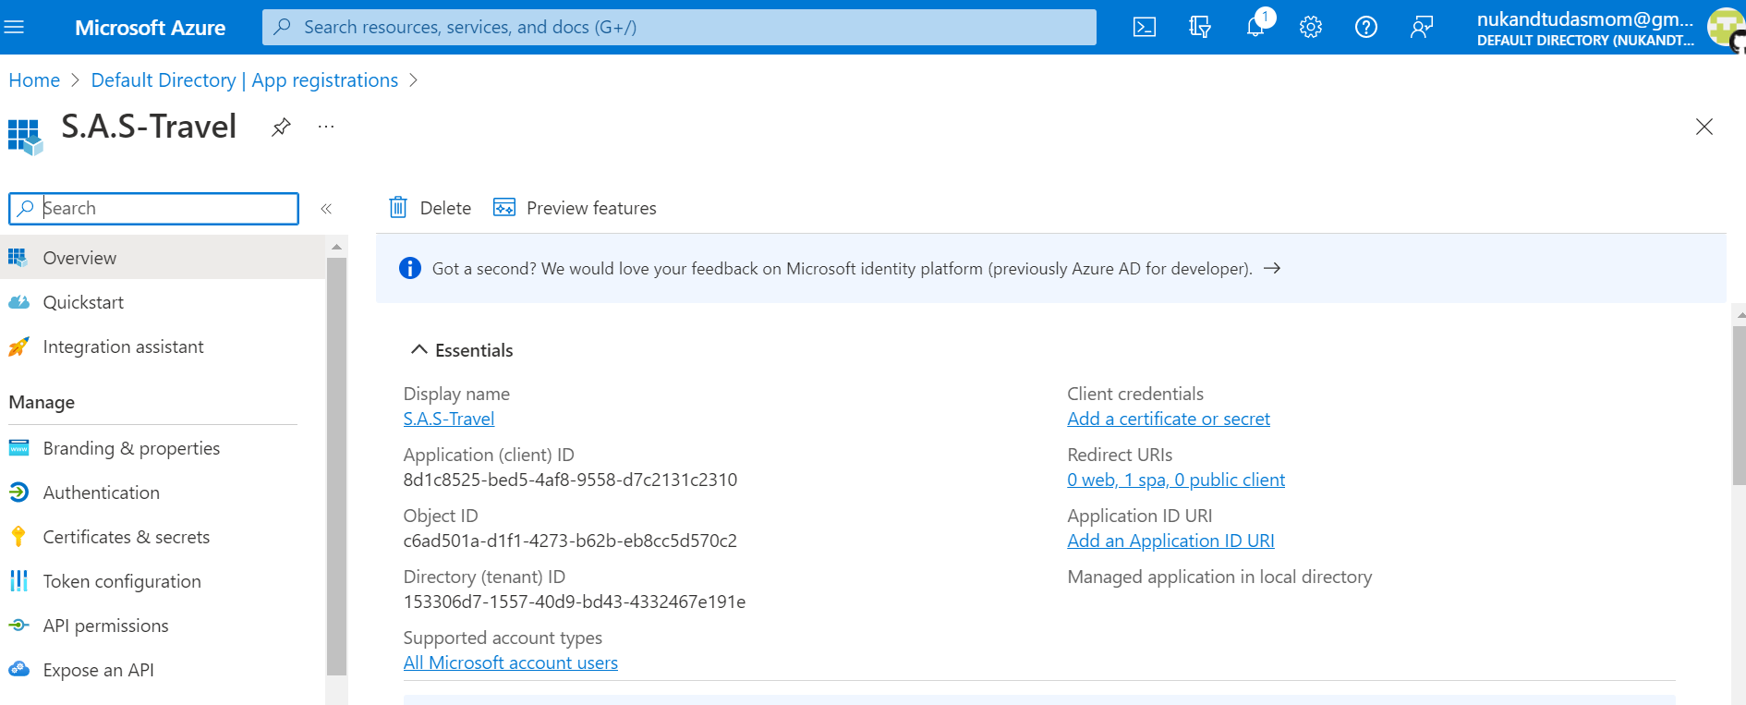
Registration of Application

Slide 15
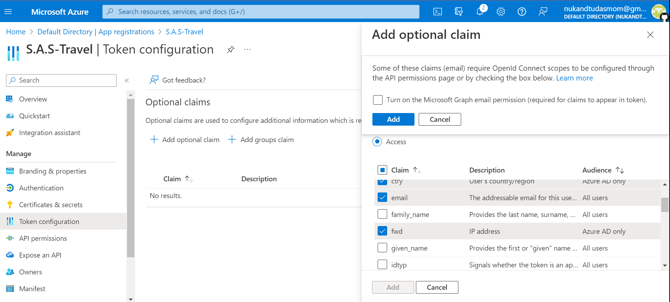
Registering an email for token assignment

Slide 16
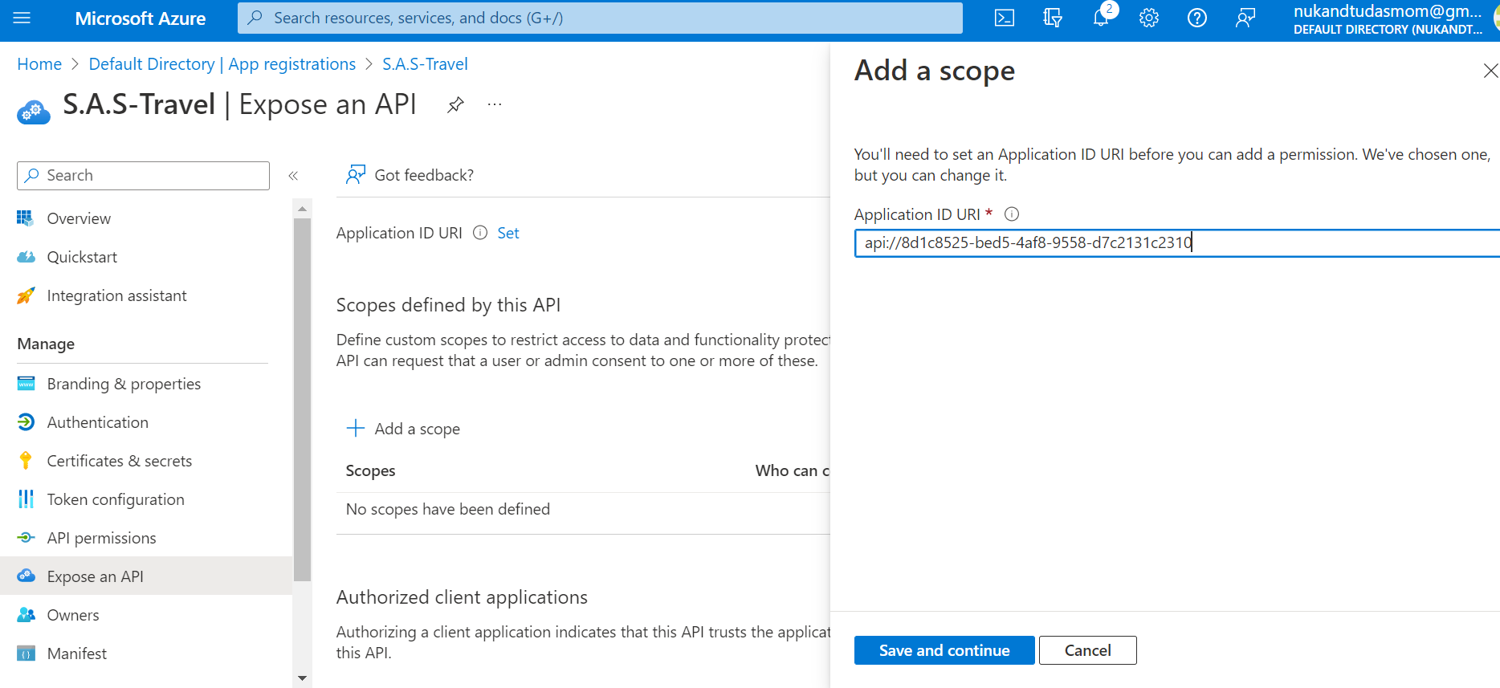
API profile set up

Slide 17
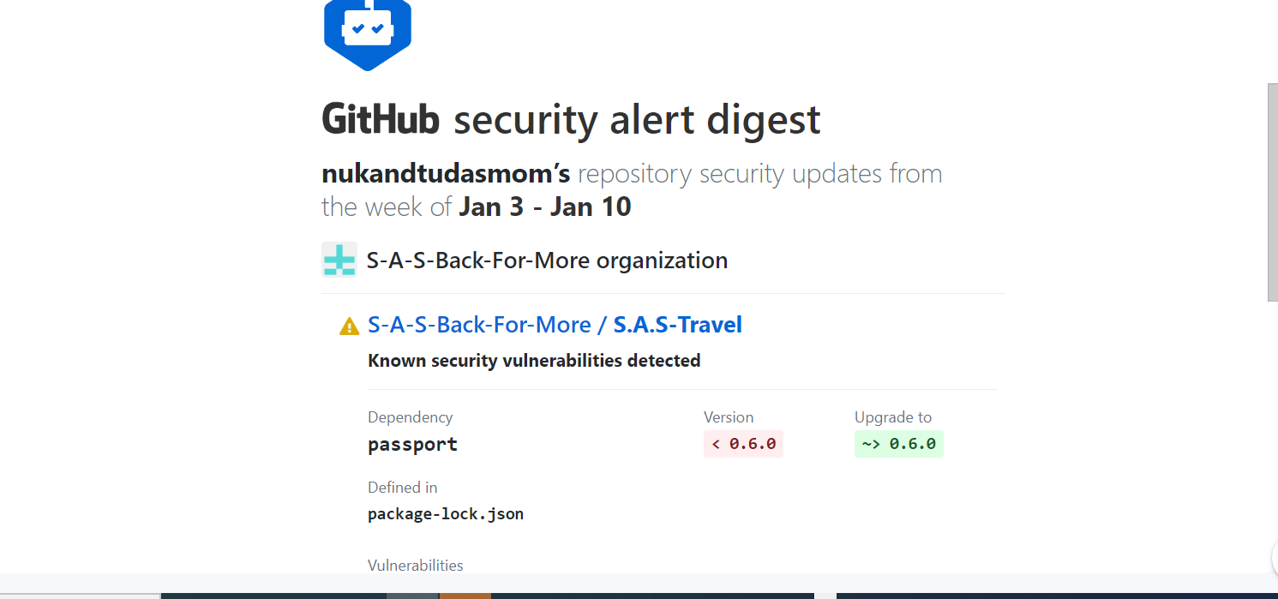
GITHUB Security notifications
Notes:
Security notifications from Verizon
The fake usernames had to be updated to different fake names

Slide 18
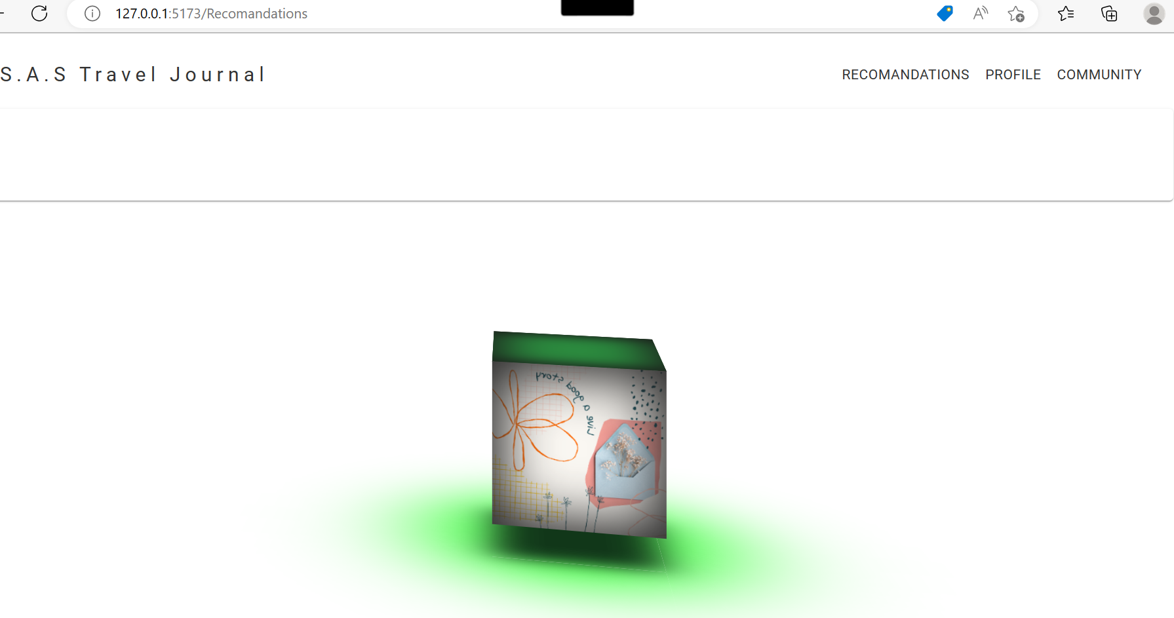
Final Product …..
Notes:
Security notifications from GitHub

